Slide 1
Standard Bank’s Offering
The fonts, font sizes, colours & styles
have been
set according to the guidelines laid down by the Marketing Division.
Please do not change any of the above.
Sarah van der Merwe
Provincial Agric Manager: KZN
Standard Bank Business Banking
27 March 2014
The information contained in this document is confidential, for internal use only and may not be distributed outside the Standard Bank Group.

Slide 2
Agenda
Who are Standard Bank Agricultural Banking?
What is our offering about?
BEE Fund – how does it work?
The information contained in this document is confidential, for internal use only and may not be distributed outside the Standard Bank Group.

Slide 3
Agricultural Banking
We have provided financial services to the agricultural sector for over 140 years. Agric Banking – 30 years old in 2010.
We are committed to:
The development of agriculture and
to adding value to farming businesses.
We have a range of specialised products and services,
Agricultural advisors and business managers.
Agricultural advisors:
Advice on business banking,
feasibility studies,
compilation of comprehensive agricultural reports,
Business managers:
They manage the relationship between you and the Bank and
have a sound knowledge of agriculture.

Slide 4
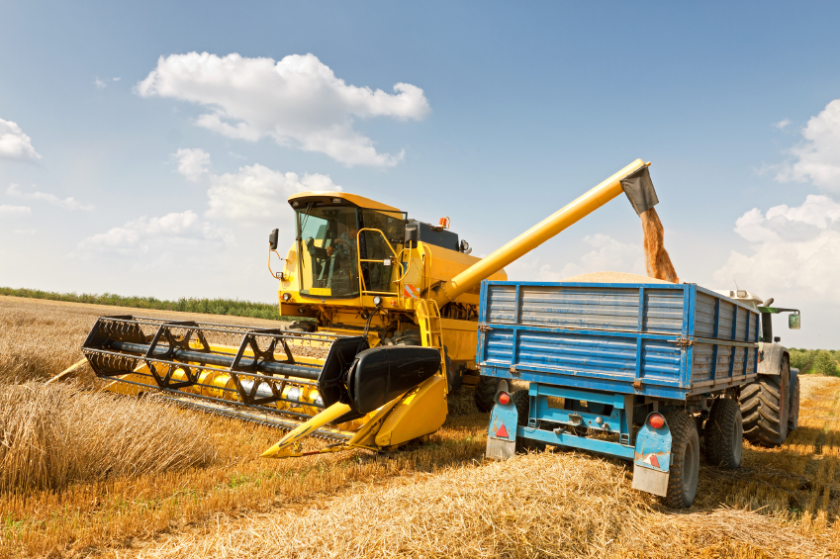
We understand the value chain integration and growth
Wholesale buyers of Agricultural produce for the purpose of:
Inputs
Production
Input suppliers
Seed
Fertilisers
Pesticides
Equipment
Processing
Ginning Co
Millers
Wine Cellars
Abattoirs
Spinners & Weavers
Input retailers
Co-ops
Agribusinesses
Packaging & Distribution
Export Co’s
Cold storage & transport
Silo owners
Service providers
Crop insurance providers
Crop spray Co’s
Irrigation Co’s
Auctioneer/marketing Co’s
Trade
Freshmark
Grain traders
Secondary Agricultural Business
Primary Agricultural Business
Secondary Agricultural Business

Slide 5
Banking Offering
Transactional Solutions
Current account, internet banking
Lending Solutions
Overdraft, term loans & production loans
Savings & Investment Solutions
Crop- and livestock insurance
Wealth creation
Life cover, Estate planning
Managing Volatility
Safex desk, Grain Procurement Team.

Slide 6
Lending Offering
 | Kind of finance
What you need the money for: | Overdraft | Business revolving Credit Plan | Business Term Loan | Medium Term Loan | Agricultural Production Loan | Vehicle and asset finance
Working Capital | Yes | Yes | No | No | No | No
Input costs, crops, livestock | Yes | Yes | No | No | Yes | No
Implements, machinery and other capital equipment | No | Yes | Yes | Yes | No | Yes
Office equipment | No | Yes | Yes | Yes | No | Yes
Vehicles | No | No | No | No | No | Yes
Property | No | No | Yes | Yes | No | No

Slide 7
Lending Offering
Overdraft:
Ideal way to finance working capital and cash flow.
Agricultural Production Loan (APL):
Short-term credit to pay for agricultural inputs.
Revolving Credit Plan (BRCP):
Paid off over 5 years,
Can revolve up to limit once 25% of the loan has been repaid.
Business Term Loan (BTL):
Term: 3 – 10 years, repayable in equal monthly instalments.
Minimum: R50,000 with no max.
Medium Term Loan (MTL):
Term 2 – 15 years, repayable in monthly, bi-monthly, quarterly, bi-annually or annual instalments.
Capital payment is fixed over the term of the loan.

Slide 8
How does the bank look at an Agribusiness?
Agribusiness
Financial Position
Repayment ability
Security
Management capability
Regulations

Slide 9
BEE Emerging Farmers Fund
Business model:
Identify a portfolio of emerging farmers in selected industries and group them in geographical areas under the mentorship of a BEE accredited operational management Company.
Create linkages between the management company and agribusinesses through the full agri value chain to maximise benefits.
The management company with its linkages will cover production loan approval, disbursement, monitoring, procurement, implementation of risk mitigation, securing markets etc.
A Mentor/or mentors accredited through the newly established Standard Bank Centre for Agribusiness Leadership and Mentorship Development with US and PWC, will be linked to the portfolio of farmers to ensure skills transfer.
Focus on 4 industries: Grain, Livestock, Citrus and Sugarcane.

Slide 10
Framework
Small/medium sized farmers with access to land- (lease agreement/ letter from local authority- duration, ha)
2. Track record- 3 years (Farming experience, production history, farming capability, business acumen, planning, records, marketing processes, profitability, equity contribution, etc)
3. APL platform for production finance, BTL/ BRCP for livestock purchases
4. Cession of the insurance and income to the bank
5. Mentor/ Man Co. Or Agribusiness- appropriate skills transfer & true empowerment
6. Off-take agreements
7. Customised structure
8. Learnings
9. Clear credit record, no carry over production debt
11. Individual entity/ group of farmers
12. Risks- (delivery, reputational and skills transfer) and how they will be mitigated;

Slide 11
BEE Emerging Farmers Fund
Eligibility: Committed black farmers with a 3 year track record, who has the aspiration to farm on a sustainable commercial scale.
We do not expect farmers to own the land.
We want to support government in their request for public/private partnership initiatives/projects in agriculture.
Intention is to remove financial uncertainty and protect members of the fund from any unforeseen events that are often related to farming.
R500m funding is dedicated to production facilities.
APL covers production and price risk and will be used as a platform for funding in the different industries.
The fund will connect agribusinesses to land reform projects and beneficiaries in a sustainable manner.
Responsible lending: Operational Management Company as well as the off-takers must be accredited.

Slide 12
Questions & Discussion

Slide 13
Contact details
Sarah van der Merwe
Provincial Agric Manager: KZN
Tel: 031 374 2142
Cell: 082 371 1040
E-mail: sarah.vandermerwe@standardbank.co.za

