Slide 1
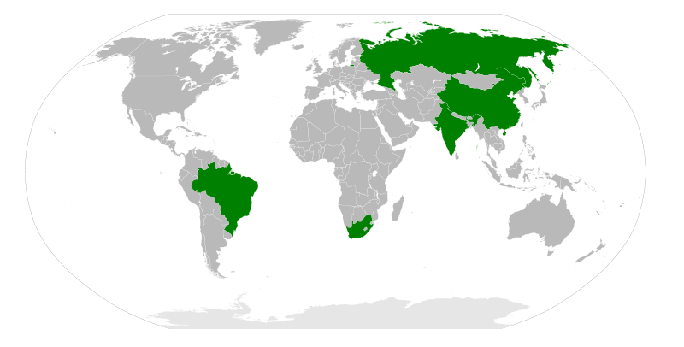
KZN DEPARTMENT OF AGRICULTURE & ENVIRONMENTAL AFFAIRS INVESTOR AND CATALYTIC PROJECTS
?
Farmer Information Sharing Summit

Slide 2
Contents
Departmental Programmes
Strategic Objectives
Investment Initiatives

Slide 3
1. Programmes
Mentorship
EXPORTER
Investment Promotion
Catalytic Agribusiness Projects
Economic & Market Information
Environmental Management
Veterinary Services
COMMERCIAL FARMER
Post settlement Mentorship
CASP
Mechanisation
Fencing & Irrigation
Livestock Sale Yards & Dip Tanks
Youth & Women Support
ENTRANT FARMER
FOOD SECURITY
Food Security (OSS Poverty Package)
Projects: Women & Youth
Training
LAND CARE
Land Care
Greening the Environment
Alien Weed Control
Liming & Soil Fertility

Slide 4
2. Investor & catalytic projects
Access local and international investments and markets for local agricultural products
Develop commercial farming entrepreneurs and agri-businesses
Enhance linkages with international partners, stakeholders and between spheres of government
Create local jobs and income, and taxes for Government

Slide 5
3. Investment initiatives

Slide 6
Objectives of the investment initiatives
To invest in agriculture and create the basis for sustainable development in the rural economy, in previously disadvantaged and under-developed areas.
To create Joint Ventures (JVs) between local Farmers and an Investor(s), unlocking un-utilised agricultural lands and ensuring an equitable profit share from subsequent agricultural production.

Slide 7
Objectives of the investment initiatives cntd.
To promote beneficiation of agricultural produce, in a manner that gives opportunities for farmers to own shares in value-adding industries.
To significantly add to the rural skills base, create jobs, improve local incomes, increase the local rates base, encourage exports and earn foreign exchange and taxes for Government.
To fulfill the national Government imperative of Food and Nutrition Security for all South Africans.

Slide 8
Receipt of intent to develop the land from investors
(Letter of intent)
Introduction of the initiative to ESID Cluster and Cabinet
(Resolution: Support)
Presentation of the initiative to amaKhosi
(agreement to table at TC)
amaKhosi table the initiative to the Traditional Council for support
(TC Resolution)
Soil tests are done to analyses suitability
(Soil Report)
Land to be developed is identified by amaKhosi
(Land Mapped & ha summed for investors)
Meeting the land owners/farmers
(Resolution and PSC Established)
Establishment of the Community Business Entity (Registered Trust)
Signing of the Agreement between investors and the Community Trust
(Operational Agreement)
Work Commences
(Business Established)
Fencing, Debushing, Soil Ripping, Discing, Fertilization, Irrigation Scheme design & installation etc.
Institutional arrangements
Planning
Presentation to Municipalities (Council Resolution
ITB Land use application (ITB Land use agreement)

Slide 9
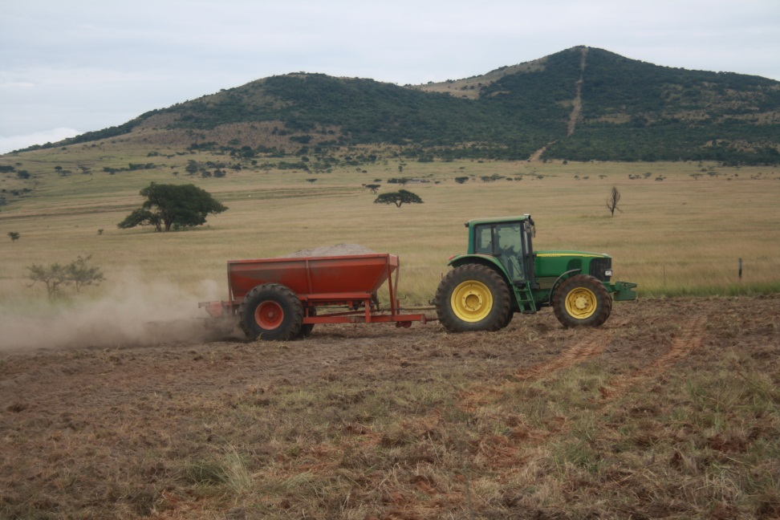
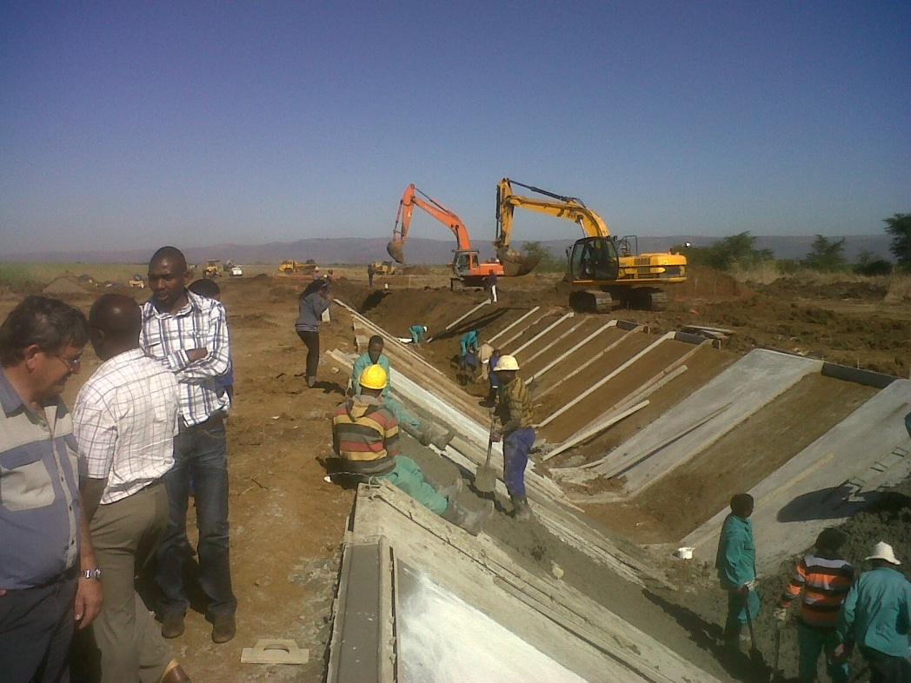
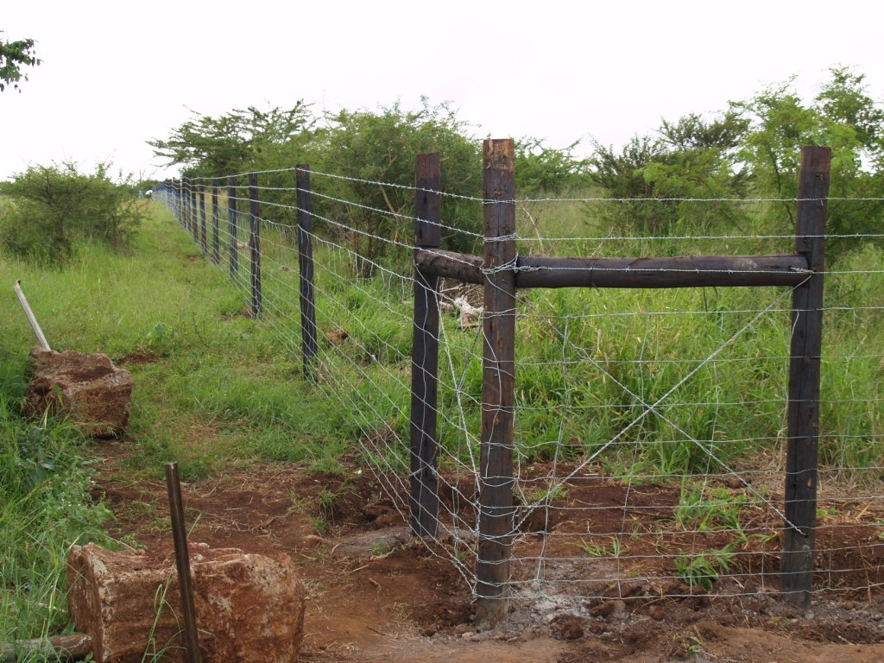
DAEA Contributions

Slide 10
INDIA
DAKE, Healthy Agro and Heritage Dairy
500ha Pulses
50ha Vegetables
3,000ha Groundnuts
1000 cow dairy
Vegetable stalls, packhouse and dairy
Areas: Tugela Estates, uMhlabuyalingana/Jozini

Slide 11
November 2011
November 2012

Slide 12
March 2013
June 2013 – beans ready for harvesting

Slide 13
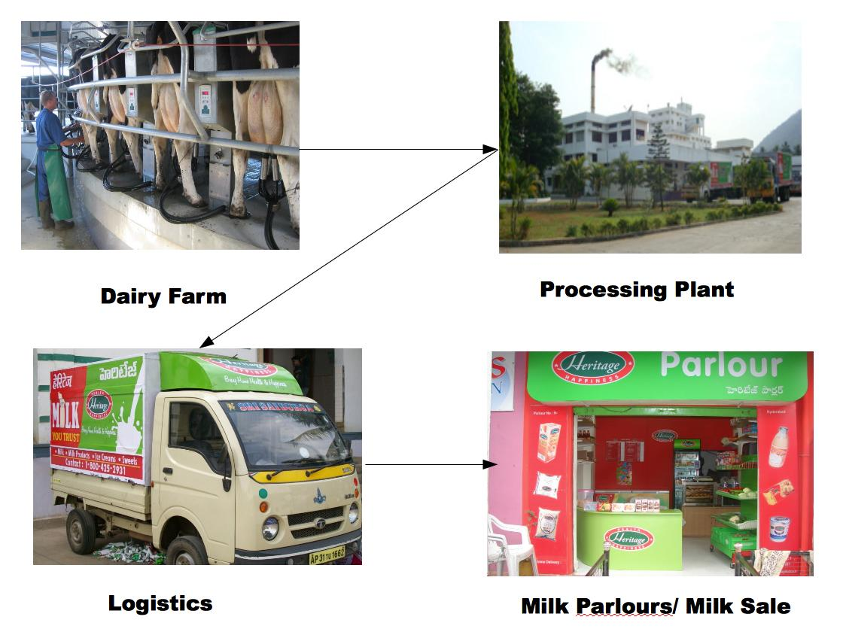

Slide 14
CHINA
BEK and Shanghai Peng-Xin Group
40,000ha crops and livestock farming
Dairy, meat processing (deboning and abattoir)
Areas: uMzimkhulu (Phase 1), Makhathini

Slide 15
ARGENTINA
Quancobi Farming, A&G International
26,110ha crop farming (soya, maize and potatoes)
Soya caking and processing plant
Areas: uThukela, abaQulusi and uMzinyathi

Slide 16
Thank you
Ngiyabonga

