Slide 1
KZN Export Week 2020
1st & 2nd December 2020

Slide 2

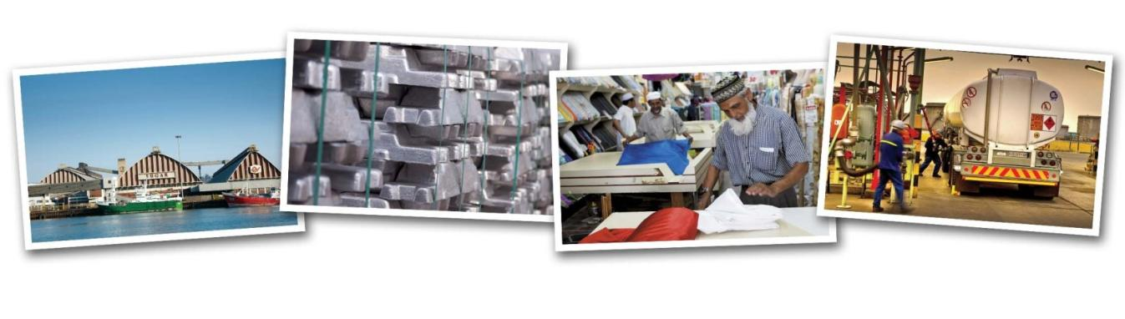
Trade & Investment KwaZulu-Natal,
The Official Trade and Investment Promotion Agency
of the KwaZulu-Natal Provincial Government and Home of the

Slide 3
OUR MANDATE
Promote, brand and market the province of KwaZulu-Natal as an investment destination
Facilitate trade by assisting local companies to access international markets
Identify, develop and package investment opportunities in KwaZulu-Natal
Provide a professional service to all clientele
Retain and expand trade and export activities
Link opportunities to the developmental needs of the KwaZulu-Natal community

Slide 4

KZN Economic Development Entities
Economic Development, Tourism & Environmental Affairs (EDTEA)
TIKZN
TKZN
DUBE TRADEPORT SEZ
ITHALA DEVELOPMENT BANK
KZN
GROWTH FUND
RICHARDS BAY SEZ
LIQUOR AUTHORITY
SHARKS BOARD
KZN FILM COMMISSION

Slide 5
OUR CORE FUNCTION
TIKZN
Investment
Promotion
Gauteng Office
Business Retention & Expansion
Knowledge Management
Export Promotion

Slide 6
SECTORS OF FOCUS
Manufacturing
Tourism
Agriculture and agro-processing
Property and infrastructure development
Services, transport & logistics
Oceans economy (incl maritime industry)
  Automotive and component manufacturing
  Clothing, textiles, footwear, leather and leather products
  Chemical and plastics manufacturing (transitioning to bio-based, renewables)
  Nature-based tourism
  Arts, culture and heritage tourism
  Hotels, resorts, houseboats and other accommodation
  MICE
  Fruit (citrus and subtropical), vegetables, grains, honey, and livestock
  Paper, furniture and other wood products
  Food and beverage processing and packaging (sugar-cane, livestock, vegetables, fruit, soya, maize, nuts)
  Residential and commercial
  Industrial parks
  Road and rail infrastructure
  Bulk infrastructure
  Trade (retail)
  Business services (BPO, finance, insurance, and other professional services)
  Ocean based tourism
  Cruise tourism
  Ports
Traditional
  Pharmaceuticals and cosmetics
  Mineral beneficiation
  Advanced manufacturing
  Renewable industry technology
  Industrial waste recycling
  Medical tourism
  Adventure tourism
  Film tourism
  Energy (biofuels), cellulose and other biomass processing
  Agricultural technology
  Cut flowers
  Medicinal and herbal plants
  Healthcare and facility development
  Private education institutions
  Green buildings
  Smart buildings
  ICT and software development
  Aviation and related services
  Film and media
  Oil and gas
  Small craft harbour and waterfront development
  Boat and ship building and repair (floating docks)
  Aquaculture
Growth

Slide 7
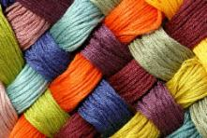
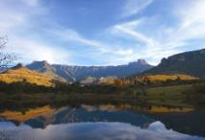
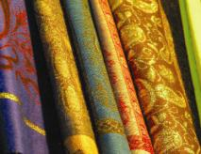
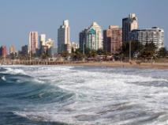
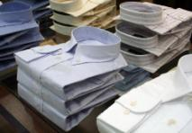

EXPORT DEVELOPMENT
Export Registration
The Export Radical Economic Transformation Programme (ERET)
  TPT & TIKZN Enterprise Development Programme
The Export Graduation Programme
  Development of Small and Medium Companies
  The Intermediary Export Development Programme
  Enhance Export Development for previously Export Graduates
Emerging Exporter Exposure Programme
  Exposing Emerging Exporters to local, national and international Exhibitions and Outward Selling Missions
Notes:
Automotive parts and components (Toyota, Motherson Sumi etc)
Sugar, prepared foodstuffs and beverages (Tongaat, Ilovo, Unilever)
Chemicals and Plastics (Sapref, Engin)
Furniture, arts & craft
Pulp & paper (Mondi. Sappi)
Engineering services (Elgin)
Electronic, communication devices (Altech UEC)
Leisure boats, transport and logistics equipment (Grinrod)
Machinery
Jewellery, base metals
Clothing, textile, body armor

Slide 8
EXPORT DEVELOPMENT
Advanced Export Training
  o Small, Medium and Large Exporter trained by Accredited Export Training Companies
Advanced Export Capacity Building Workshops and Master Classes
  o Focused Workshops and Master Class Sessions on appropriate and relevant topics (INCOTERMS 2020, AfCFTA, ALGOA, BREXIT, Trade Wars etc)
Local and International Export Mentorship Programmes
  o KZN Competitiveness Programme implemented by Productivity SA
  o Mentorship Offered through the Dutch PUM Program, German SES Program and the Swiss SIPPO Program.
Advanced Export Consultations
  DSM Report Consultations , Site Visits, Incentives Facilitation
Notes:
Automotive parts and components (Toyota, Motherson Sumi etc)
Sugar, prepared foodstuffs and beverages (Tongaat, Ilovo, Unilever)
Chemicals and Plastics (Sapref, Engin)
Furniture, arts & craft
Pulp & paper (Mondi. Sappi)
Engineering services (Elgin)
Electronic, communication devices (Altech UEC)
Leisure boats, transport and logistics equipment (Grinrod)
Machinery
Jewellery, base metals
Clothing, textile, body armor

Slide 9
EXPORT PROMOTION
Market Development Workshops and Briefing Sessions
Trade Lead Distribution
Export Promotion Consultations and use of DSM
Participation and coordination of KZN Delegates on OSM’s, ITI’s, Local Exhibitions and National Pavilions
Support to clients on Individual event participation
Hosting of Inward Buying Missions
Coordination of Export Week
Facilitation of access to Export Incentives (TAF, FAS,DTI EMIA)
Registration on the KZN Export Information Portal
Notes:
Automotive parts and components (Toyota, Motherson Sumi etc)
Sugar, prepared foodstuffs and beverages (Tongaat, Ilovo, Unilever)
Chemicals and Plastics (Sapref, Engin)
Furniture, arts & craft
Pulp & paper (Mondi. Sappi)
Engineering services (Elgin)
Electronic, communication devices (Altech UEC)
Leisure boats, transport and logistics equipment (Grinrod)
Machinery
Jewellery, base metals
Clothing, textile, body armor

Slide 10
TRADE PROMOTION VALUE CHAIN
Coordinate Trade Missions
Market Products at Trade Shows
Inward Delegation
Facilitate Trade Opportunity Or Referrals For Finalisation Of Transaction
Conclude Trade Deal
Feedback On Exports Secured
Identification of Existing/Emerging Exporters
Trade Promotion and Marketing
Country Targeting and Scoping

Slide 11
Non-Financial
Market Development Support
Training, Development and Capacity Building Programmes
Access to Market Intelligence Report (DSM, FITCH Solution, Quantec,etc)
Access to the KZN Export Information Portal
Incentive Application Support
Financial
International Mentorship Programmes (PUM, SIPPO, SES)
Financial Assistance Support Scheme (FAS)
Technical Assistance Fund (TAF)
Export Market Investment Assistance (EMIA)
Etc……
INCENTIVES FACILITATED VIA TIKZN

Slide 12
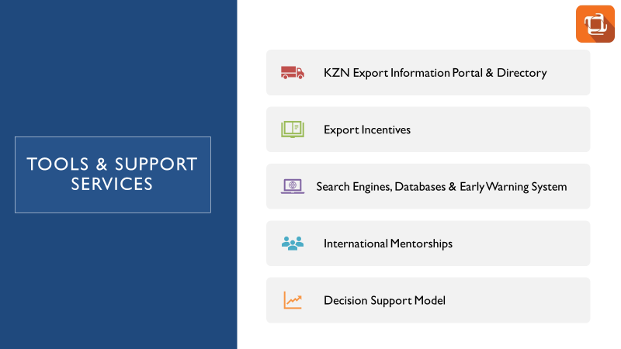

Slide 13
EXPORT PRODUCTS FROM KZN
Automotive parts and components
Sugar, prepared foodstuffs and beverages
Chemicals and Plastics
Furniture, arts & craft
Pulp & paper
Engineering & Consultancy services
Electronic, communication devices
Leisure boats, transport and logistics equipment
Machinery
Jewellery, base metals
Clothing, textile, body armor
Notes:
Automotive parts and components (Toyota, Motherson Sumi etc)
Sugar, prepared foodstuffs and beverages (Tongaat, Ilovo, Unilever)
Chemicals and Plastics (Sapref, Engin)
Furniture, arts & craft
Pulp & paper (Mondi. Sappi)
Engineering services (Elgin)
Electronic, communication devices (Altech UEC)
Leisure boats, transport and logistics equipment (Grinrod)
Machinery
Jewellery, base metals
Clothing, textile, body armor

Slide 14

``
KZN TOP 10 EXPORTS DESTINATION MARKETS 2019 (Billions)
NETHERLANDS
R 12.7
GERMANY
R 15.8
R 6.4
R 5.0
R 8
UK
USA
R 4.5
CHINA
R 6.5
FRANCE
JAPAN
R 7.7
INDIA
R 6.3
NAMIBIA
R 5.8
BOTSWANA
Total KZN Exports to Global Markets = R145,85 Billion [11,25% of SA & +650 products]
Total KZN Imports from Global Markets (9,76%) = R124,28 Billion [9,76% of SA]
Total SA Exports to Global Markets =R1 296,97 Billion
Total SA Imports from Global Markets =R1 273,27 Billion

Slide 15
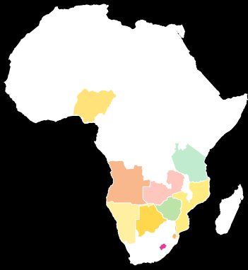
``
KZN TOP 10 EXPORTS AFRICA MARKETS 2019 (Billions)
Zambia
R3.3
Tanzania
R1.2
Kenya
R 1.2
Angola
R1.6
Mozambique
R2.8
Namibia
R6.3
Swaziland
R3.1
Botswana
R5.8
Zimbabwe
R2.3
Lesotho
R1.9
Total KZN Exports to Africa = R37,39 Billion [10,87% of SA]
Total SA Exports to Africa = R343,99 Billion

Slide 16
THE AFCFTA: BOOSTING INTRA-AFRICA TRADE
According to UNECA, AfCFTA promises to unlock intra-Africa trade to grow by 52% by 2022.
In 2015 WTO provided a comparative analysis of intra-regional trade as follows:
  intra-Africa trade at 18%;
  intra-Asian trade at 52%;
  intra-North American trade at 50%; and
  intra-EU trade at 70%.
Africa’s share of world trade estimated to be at 3%. This proves that Africa needs to do more to expedite market integration.

Slide 17
BENEFITS TO INCREASING INTRA-AFRICA TRADE
Intra-Africa Trade helps grow economies, creates jobs, and reduces poverty.
In March 2018, the signing of the African Continental Free Trade Area Agreement (AfCFTA). This will see a single African market of over a billion consumers with a total GDP of over US$3 trillion.
The share of Intra-African exports as a percentage of total African exports has increased from about 10% in 1995 to around 17% in 2017.
When African countries trade with themselves they exchange more manufactured and processed goods, have more knowledge transfer, and create more value.
Trade diversification of exports is important as it allows countries to build resilience to movements in demand.
Intra-Africa Trade supports a shift from an over dependence on commodities to higher value-added products and services.
Economic diversification allows for more inclusion of small and medium sized enterprises.
Intra-Africa Trade offers potential for agricultural products and will increase trade in agricultural products.

Slide 18
MARKETS ACCESS INITIATIVES TO GROW INTRA-AFRICA TRADE:
Market Development Initiative with Trade Commissioners, Investment Promotion Agencies, Exports Councils, etc.
Trade regulation and compliance with Intertek, Bureau Veritas, SGS,
Online/Physical Trade Mission (Conference and B2B arranges for promotion of intra Africa trade)
Encourage the participation of SMME in international Trade
Follow up with inbound and outbound missions to enhance market penetration within 6 months of post initial trade engagement.
B2B arranges for promotion of intra Africa trade at least once per annum.
Hosting of delegates from Key African Markets at KZN Export Week, KZN Investment Conference, etc.

Slide 19
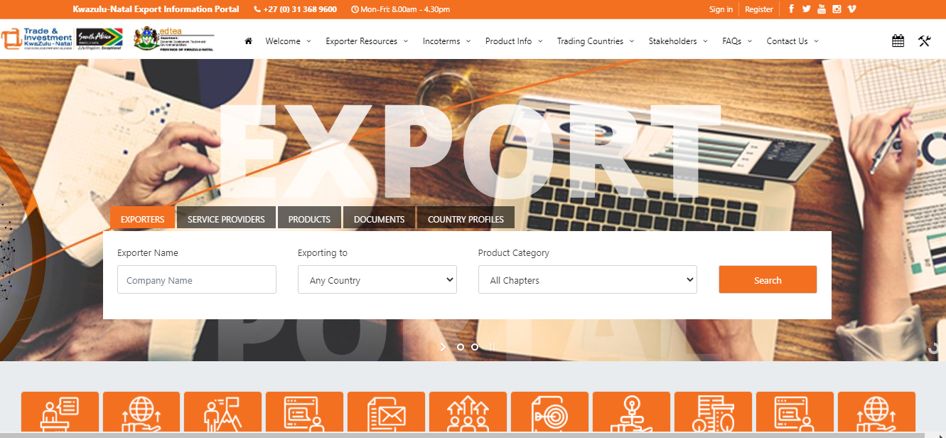
KZN EXPORT INFORMATION PORTAL
Notes:
Automotive parts and components (Toyota, Motherson Sumi etc)
Sugar, prepared foodstuffs and beverages (Tongaat, Ilovo, Unilever)
Chemicals and Plastics (Sapref, Engin)
Furniture, arts & craft
Pulp & paper (Mondi. Sappi)
Engineering services (Elgin)
Electronic, communication devices (Altech UEC)
Leisure boats, transport and logistics equipment (Grinrod)
Machinery
Jewellery, base metals
Clothing, textile, body armor

Slide 20
































Major Companies in Kwazulu-Natal

Slide 21

Notes:
Automotive parts and components (Toyota, Motherson Sumi etc)
Sugar, prepared foodstuffs and beverages (Tongaat, Ilovo, Unilever)
Chemicals and Plastics (Sapref, Engin)
Furniture, arts & craft
Pulp & paper (Mondi. Sappi)
Engineering services (Elgin)
Electronic, communication devices (Altech UEC)
Leisure boats, transport and logistics equipment (Grinrod)
Machinery
Jewellery, base metals
Clothing, textile, body armor

Slide 22


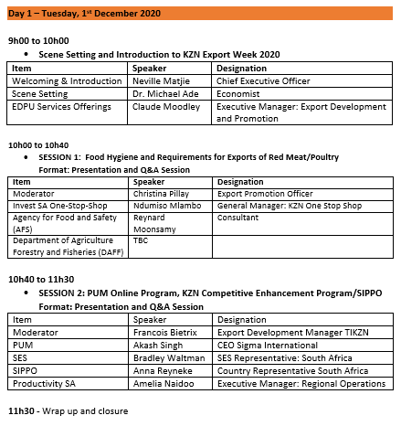


Slide 23
